Slide 1

Congratulations on installing
Let’s take a quick tour of the main features.

Slide 2
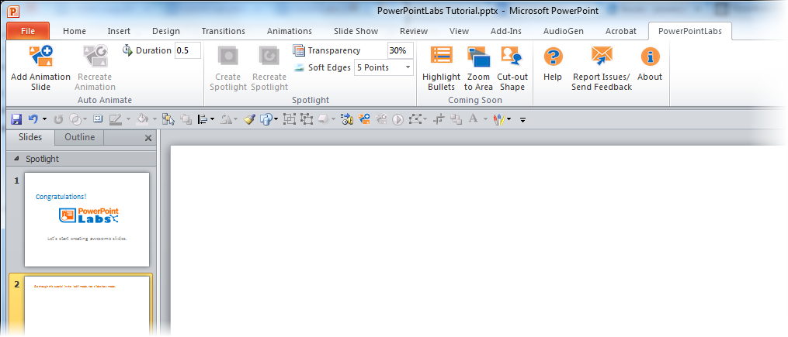
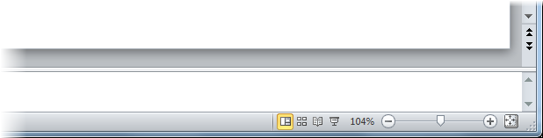
Please go through this tutorial in the ‘edit’ mode, not ‘slideshow’ mode.

Slide 3
This tutorial explains PowerPointLabs’ features at the point you installed the plugin.
If you installed the plugin some time back, please refer to the Documentation page of our website for more up-to-date instructions.

Slide 4
Let’s try the Spotlight feature

Slide 5


1. Click on this blue shape to ‘select’ it.
2. While the shape is selected, click the button in the ribbon
Phase A
Phase B
Phase C
Step 1
Step 2
Step 3

Slide 6
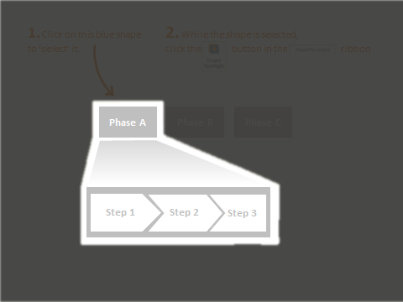



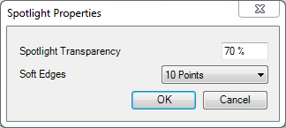
3. Did you notice the new slide with a spotlight? You can press Ctrl+Z (Undo) to reverse the effect.
4. You can also adjust the darkness (transparency) and softness (soft edges) of the spotlight.
a. Adjust these settings.
b. Select the shadow-like shape.
c. Click this button.

Slide 7
Next, let’s try the Auto-Animate feature

Slide 8

1. Let’s say you want to animate these shapes so that they end up in the positions given in the next slide.
Research
Marketing
Profit
Development
2. While this slide is selected, click the button. That should insert a new slide containing the animation.

Slide 9
Research
Marketing
Development
Profit

Slide 10
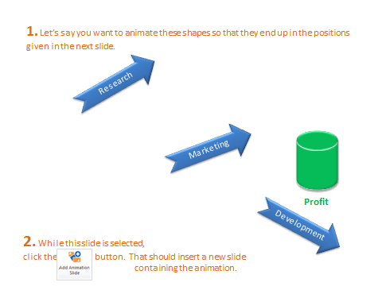
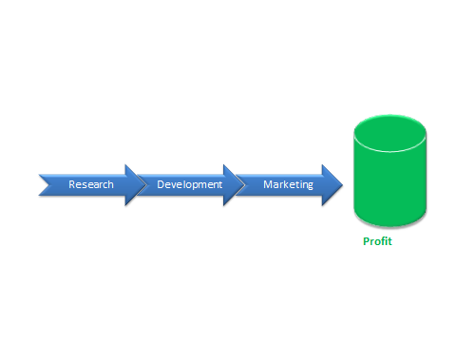
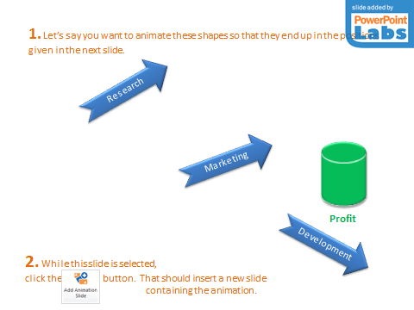

3. To tweak the animation,
a. Adjust the positions on either of these slides.
start slide
end slide
animation slide
b. Select any of the three slides.
c. Click this button.

Slide 11
Next, let’s try the Animate in slide feature

Slide 12

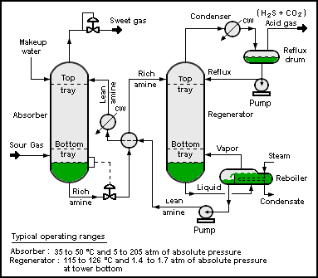
1. Select the four blue circles in any order and click the button.
2. When you ‘play’ the slide show ( ), you should see a single circle animated in the order you selected the four circles previously.
Notes:
Picture credit: Wikipedia

Slide 13
Auto zoom features are next.

Slide 14

1. Select the blue rectangle s in any order (Ctrl+click) and click the zoom to area button.
2. ‘Play’ the slide show ( ) to see the zooming and panning effects generated by PowerPointLabs. If you would like each zoom/pan effect to be put in a separate slide, click the expand ( ) icon below the Zoom to Area button to access settings and select ‘Put all zoom effects on separate slides’ option.

Slide 15




2. Select the blue rectangle and click the button.
Inputs
Process
Output
Ingredient A (60%)
Ingredient B (25%)
C (15%)
3. ‘Play’ the slide show ( ) to see drill down effect generated by PowerPointLabs. The effect tells the audience which part of this slide corresponds to the content of the next slide. For example, here it gives audience the feeling that you are now drilling down to details about the ‘Process’ part of this slide.

Slide 16
L
X
Y
Z
M

Slide 17

4. Select the blue rectangle and click the button to generate a step back effect from the previous slide.
Inputs
Process
Output
Ingredient A (60%)
Ingredient B (25%)
C (15%)
5. Go back a couple of slides and ‘play’ the slide show to see the step back effect generated. This effect can be used to indicate that you are stepping back to take a look at where the details you have been discussing fit into the big picture.

Slide 18
Next, let’s try the Auto crop feature

Slide 19



1. Select the blue shapes (ctrl + click) and click the button. It will crop the images behind to match the outlines of the shapes.
Notes:
This will play at the beginning.
[afterClick] This will play after you click.

Slide 20

2. You can apply other default PowerPoint effects such as soft-edges to enhance the resulting cropped image even further.
Your child today is …
… the young adult of tomorrow.
Notes:
This will play at the beginning.
[afterClick] This will play after you click.

Slide 21
Next, let’s try the Auto narrate and Auto captions features

Slide 22

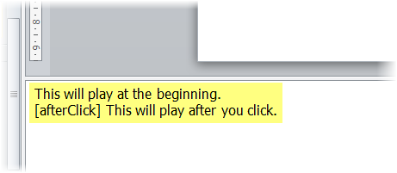

1. Click the button. It will generate an audio narration for this slide based on the slide notes. Play the slide and listen to the generated audio narration.
2. Click the button to generate sub-titles (captions) as well. Play again to experience both audio and captions at the same time.
Notes:
This will play at the beginning.
[afterClick] This will play after you click.

Slide 23

Thanks for taking the quick tutorial.
For find more information about these features (and how to tackle common issues), visit the documentation on our website.
We’d love to hear your feedback. Contact us at pptlabs@comp.nus.edu.sg
Happy PowerPointing!

Slide 24
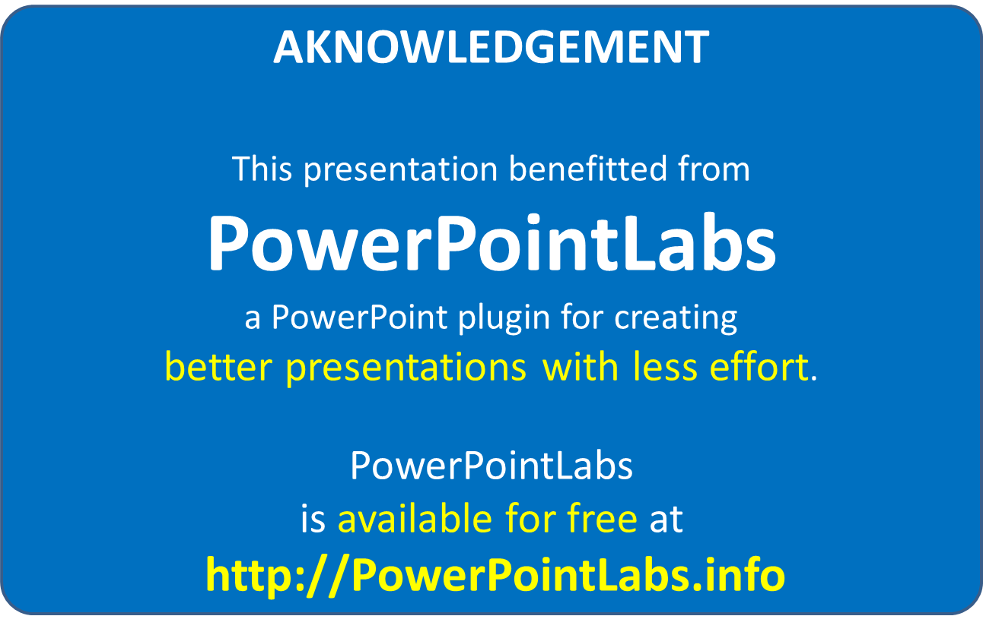
This slide is added by PowerPointLabs. It will not show up during the presentation.

